Slide 1


Rowan Atef ID:231001403
Samaa Awwad ID:231002236
Injy Hatem ID::231000596
Amira mommtaz ID: 231001071

Slide 2

Medical Laboratory System
A closer look for Laboratory Database system

Slide 3
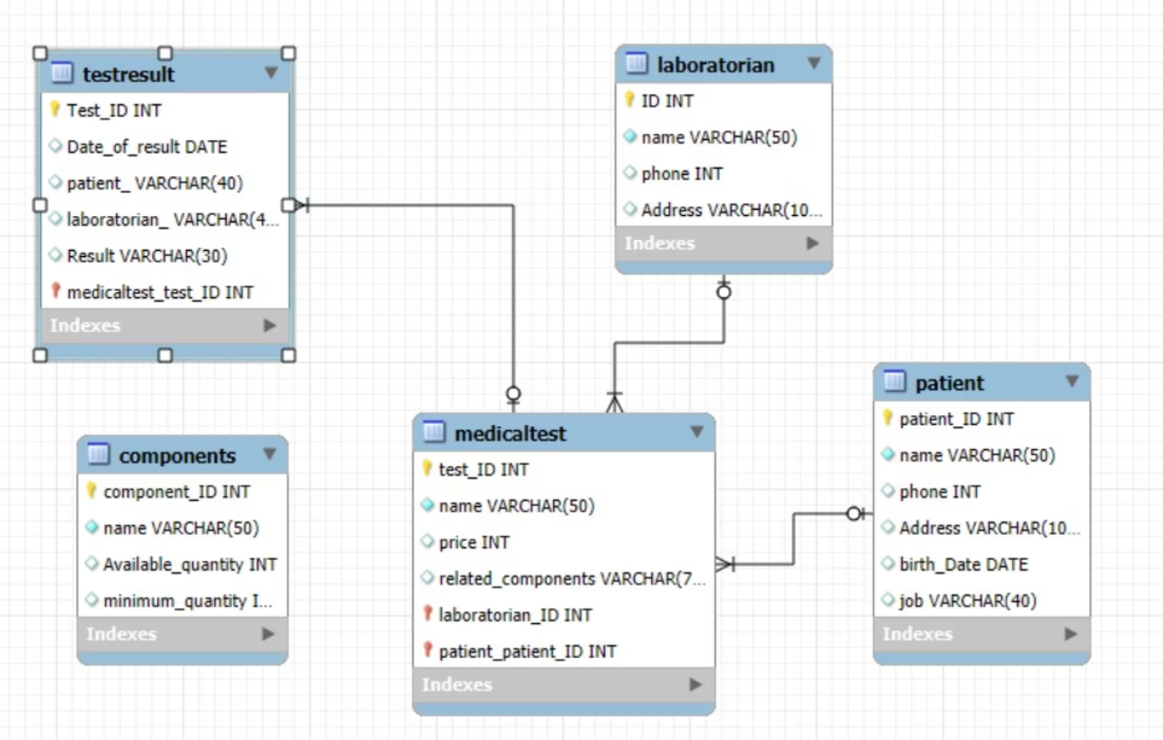
EER Model

Slide 4
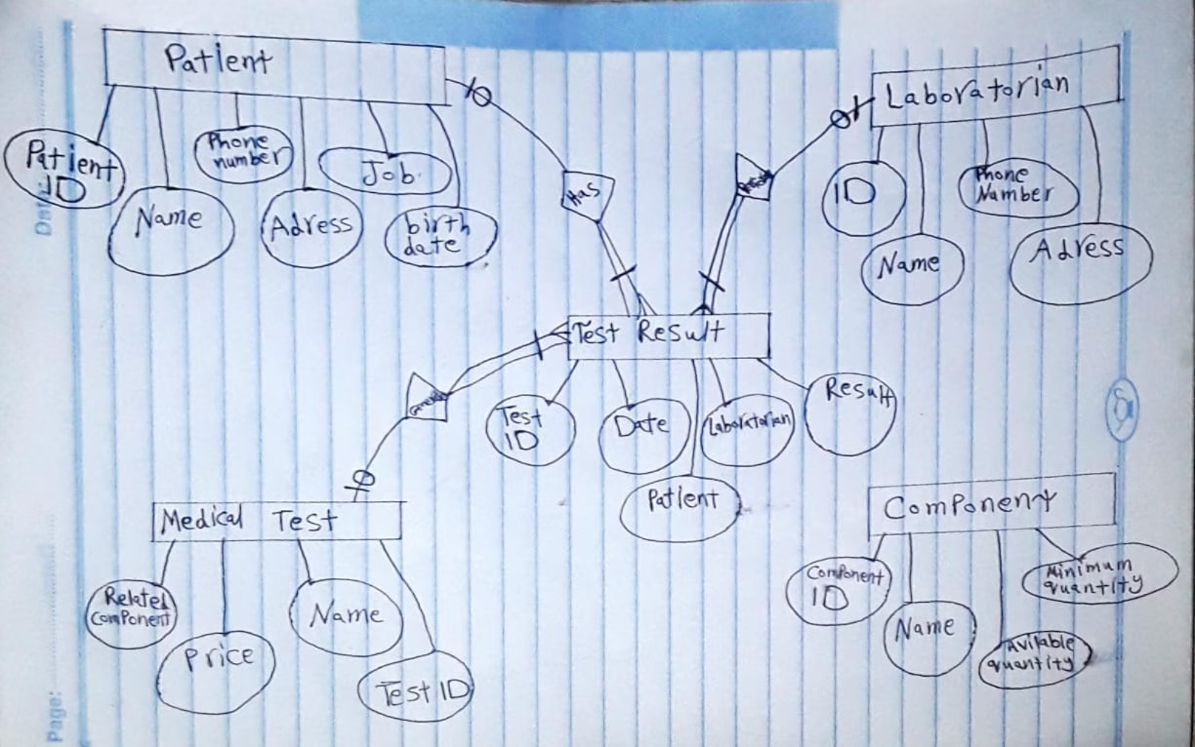
Core Entities and Attributes

Slide 5
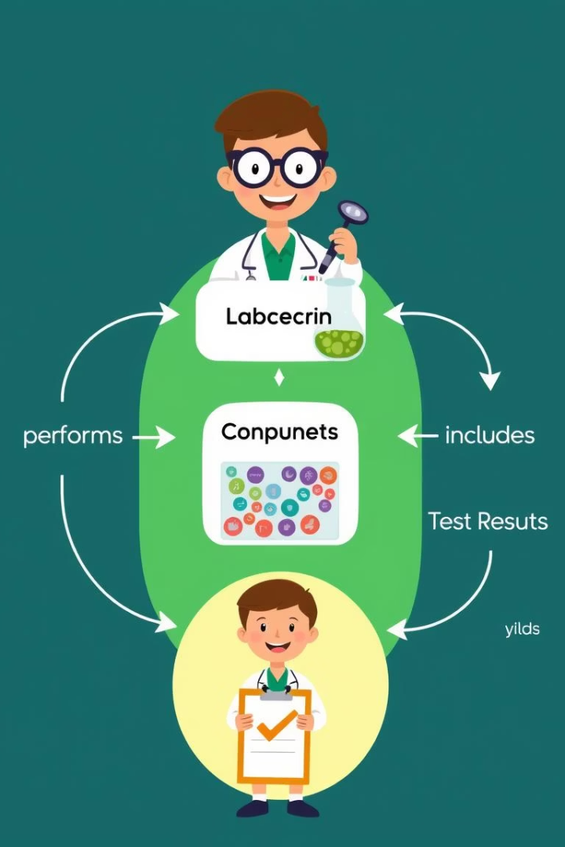
Relationships
1
Laboratorian to TestResult
(one-to-many).
2
Patient to TestResult
(one-to-many).
3
MedicalTest to TestResult
(one-to-many).

Slide 6

Participation Constraints
Laboratorian to TestResult:
Laboratorian (optional), TestResult (mandatory)
Patient to TestResult:
Patient (optional) , TestResult (mandatory)
MedicalTest to testResult
MedicalTest (optional) , TestResult(Mandatory)

Slide 7
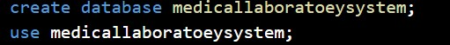
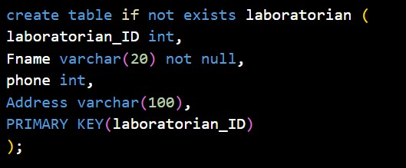
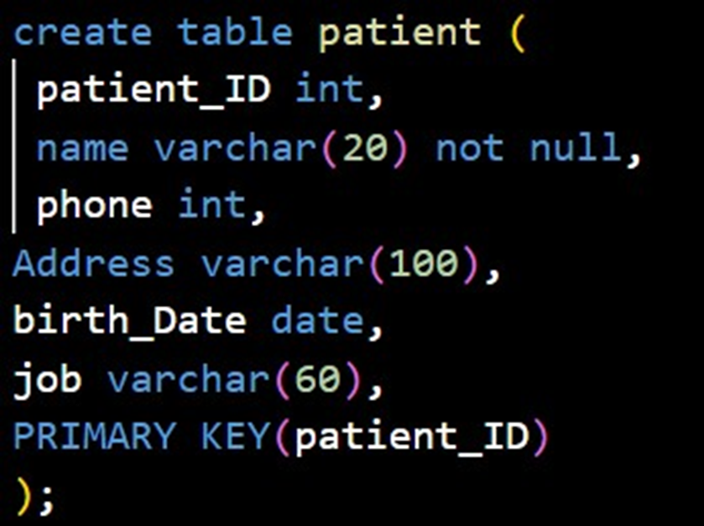
DDL Usage:

Slide 8

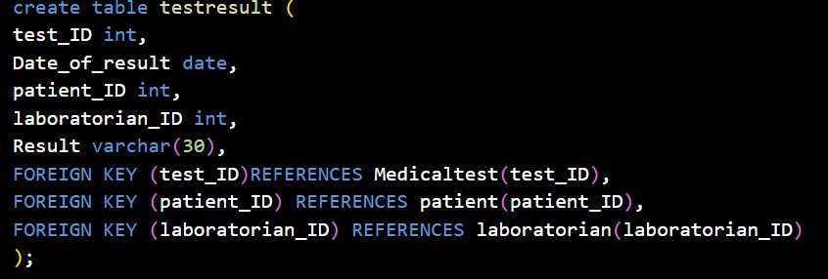
Database Schema: Tables and Keys

Slide 9
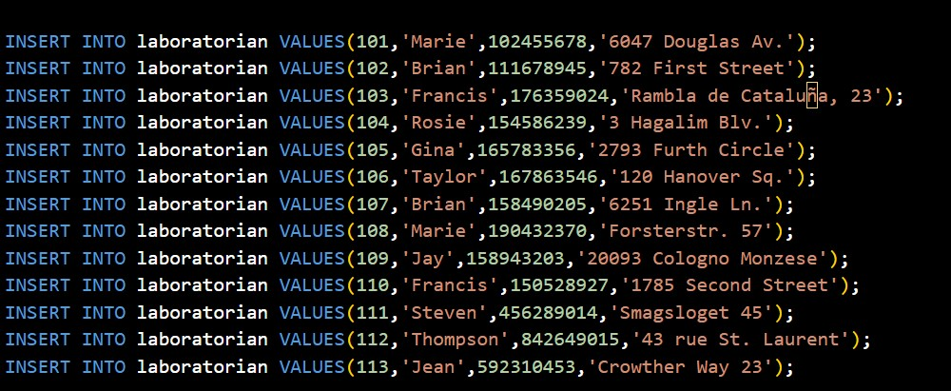
SQL Scripts: DDL and DML Examples
DDL Scripts
DML Queries
Sample queries for inserting, updating, and retrieving data from the MLS database.
Define tables, keys, and constraints to structure the database.

Slide 10
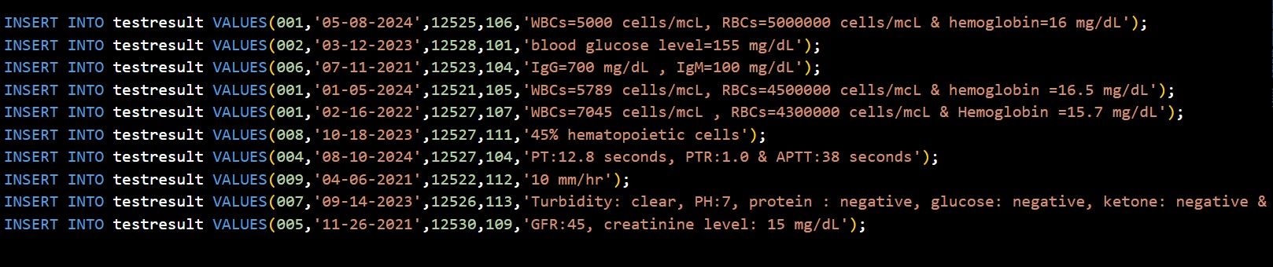
Example Data:

Slide 11
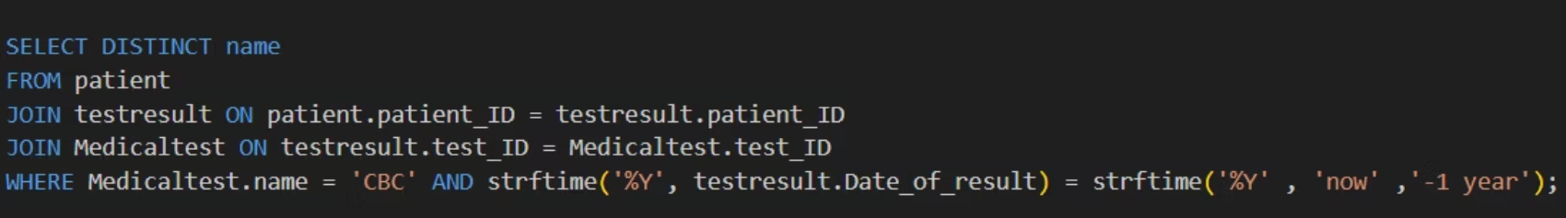
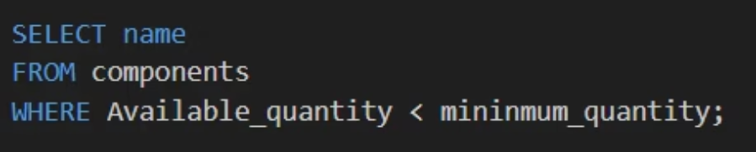
Sample of Data coding:

Slide 12
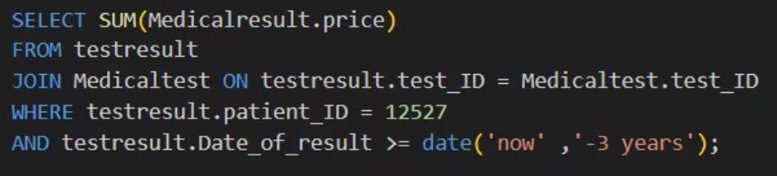
Sample of Data coding:

Slide 13


Future Prospects:
AI-Powered Analytics
Patient Management
Lab Staff Coordination
IoT Device Connectivity

Slide 14

System Benefits and Efficiency
Improved Test Tracking
Data Accuracy
Ensures relational integrity through strict database constraints.
Streamlines recording and retrieval of test results for patients.
Decision Support
Advanced queries enable informed business and clinical decisions.

Slide 15

Thank you…

